Slide 1
MURAT (Multi-task Representation Learning for Travel Time Estimation)
August,2018
KDD
Conference Rank: CCF A
汇报人：张天璞

Slide 2
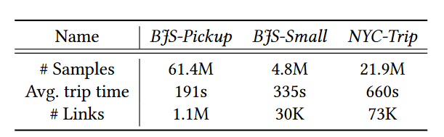
简介
数据集
BJS-Pickup
from May 1st 2017 to Oct 31st 2017
NYC-Trip
from Nov 1st 2013 to Dec 31st 2013
难点分析
通过三种语义的节点embedding更全面的获取特征进而使用残差卷积模型进行多任务预测
1、有限的可用信息以及复杂的时空依赖性

Slide 3




Preliminaries
Road Network
预测目标
1.predicting the travel time
2.the travel distance
3.the number of links in the trip
4.the number of traffic lights
5.the number of turns
Trip
$$P^{(i)}=(p_{1}…p_{s})$$
$p=(latitude, longitude,time)$

Slide 4
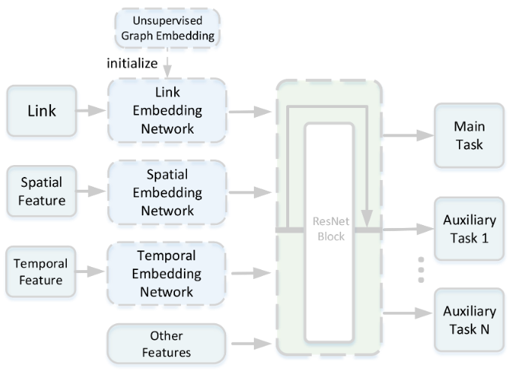
模型结构

Slide 5



模型结构
Link Embedding Network
Supervised
Unsupervised
DeepWalk

Slide 6
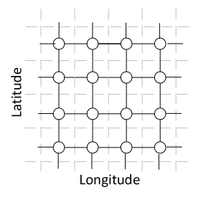
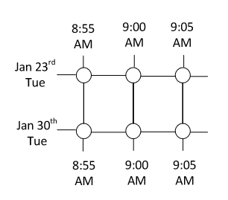
模型结构
Spatial Embedding Network
Loss Function
Temporal Embedding Network

Slide 7
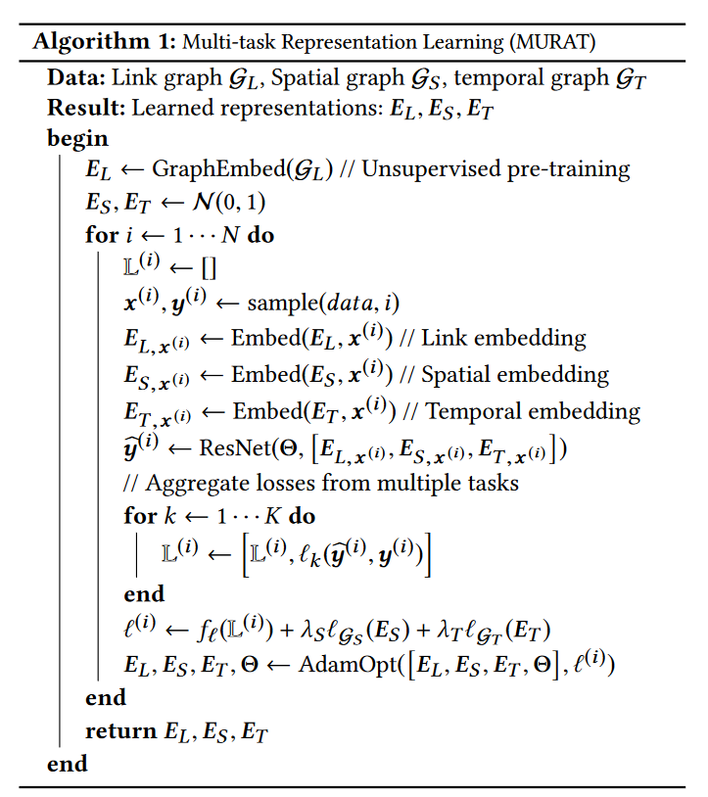
模型结构

Slide 8
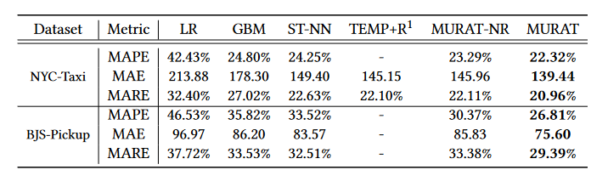
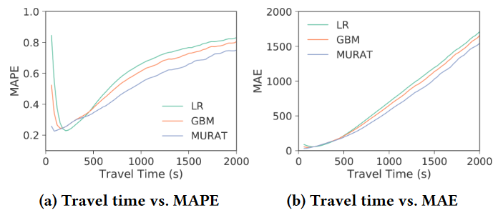
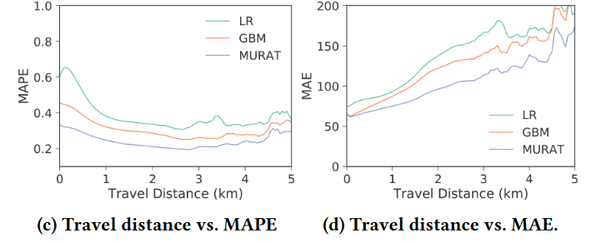
实验
与其他模型预测效果对比

Slide 9
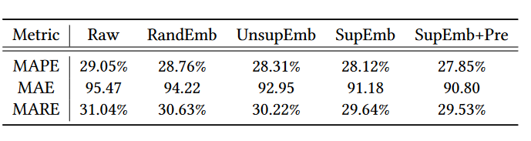
实验
Effect of Link Embedding
Raw: model without link embedding
RandEmb: which embeds each link as a vector of random Gaussian noise.
UnsupEmb: which uses unsupervised graph embedding, i.e., DeepWalk [26], to generate the link representation.
SupEmb: supervised embedding where the embedding of each link is first initialized as a vector of random Gaussian noise;
SupEmb+Pre: Supervised embedding with unsupervised pretraining using DeepWalk.

Slide 10
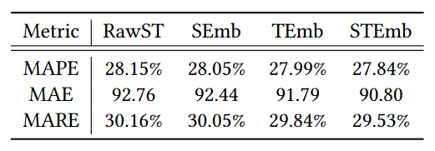
实验
Effect of Spatiotemporal Embedding
RawST: neither the spatial nor the temporal embedding is used.
SEmb: only the spatial embedding is used.
TEmb: only the temporal embedding is used.
STEmb: both the spatial and the temporal embeddings are used.

Slide 11
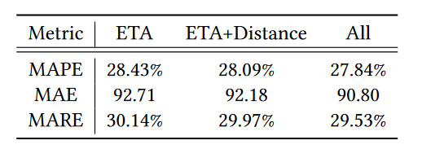
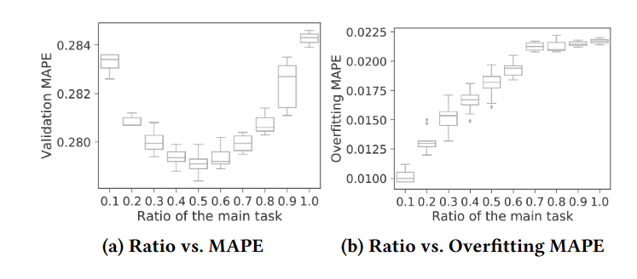
实验
Effect of Multi-task Learning

Slide 12
END
Thank you

